Slide 1
Entrepreneurship
An Introduction
Andrew Triganza Scott
MBA(Maas), M.Ed (Melit), BPsy (Hons), PGCE

Slide 2
What is an Entrepreneur?
Entrepreneur: A person who organizes and manages an enterprise, especially a business, usually with considerable initiative and risk.
Initiative: Readiness and ability in initiating action.
Risk: The hazard or chance of loss.

Slide 3
What is an Entrepreneur?
“An entrepreneur is someone who perceives an opportunity and creates an organization to pursue it.“
Source: The Portable MBA in Entrepreneurship, 2nd Ed.; William D. Bygrave, Editor. John Wiley and Sons Publishers, 1997.

Slide 4
Who is an Entrepreneur?
In the U.S., approximately 4% of the adult population is actively involved in starting a business at any given time.
One (1) out of every two (2) adults has tried to start a business at some time in his or her life.
Source: Entrepreneurship 3rd Ed., Lambing and Kuehl; Prentice Hall; Pg 25

Slide 5
What Does it Take to Be Successful?
“In entrepreneurship, luck is where preparation and opportunity meet.”
Source: The Portable MBA in Entrepreneurship, 2nd Ed.; William D. Bygrave, Editor. John Wiley and Sons Publishers, 1997.

Slide 6
What Does It Take to Be Successful?
“The idea is not what is important.
In entrepreneurship; ideas are a dime a dozen.
Developing the idea, implementing it, and building a successful business are the important things.”
Source: The Portable MBA in Entrepreneurship, 2nd Ed.; William D. Bygrave, Editor. John Wiley and Sons Publishers, 1997.

Slide 7
What Does It Take to Be Successful?
“Would-be entrepreneurs who are unable to name customers are not ready to start a business.
They have only found an idea and have not yet identified a market need.”
Source: The Portable MBA in Entrepreneurship, 2nd Ed.; William D. Bygrave, Editor. John Wiley and Sons Publishers, 1997.

Slide 8
Where Do You Start?
Think about WHO is going to want your product/service, what they will PAY for it, what will you NEED to carry it off, and how will you MAKE MONEY someday? That is, make a PLAN !!!
Success depends on:
positive cash flow, growth,
value creation.

Slide 9
The Importance of Value Creation
A successful business is one that delivers value to its customers and creates value for its owners.

Slide 10
The Importance of Value Creation
Value is delivered to your customers when you do something for them:
Better
Cheaper
Faster
Cooler
Different
However, it is likely that none of these will work for long, so continuous improvement and innovation are essential.
nt

Slide 11
The Importance of Value Creation
Value is created for the owners when:
You do more with their money than they could do with it themselves
You invest in productive activities that earn rates of return greater than their risk-adjusted costs of capital.
The present value of future cash flows exceeds the startup costs.

Slide 12
The Importance of Value Creation
Value is created by:
Exploiting proprietary physical resources
Possessing proprietary knowledge or expertise
Creating a new or improved product, process, or service
Staying ahead of the competition through constant improvement and innovation

Slide 13
Revenue Models
Revenue comes from:
Selling or licensing a product
Selling or licensing a service
Creating a transaction pipeline
Trading products or services
Selling advertising
Investing

Slide 14
Planning for Success
Don’t plan a business for today – Plan it for at least a year from now.
Moore’s Law: Computing power will roughly double every 18 months.
Bandwidth will continue to increase for most users almost ad infinitum.
People will live longer and maintain active lifestyles far after retirement.
Energy sources and consumption patterns will change drastically.
The world will continue to be a very dangerous place.

Slide 15
Planning for Success
Think about the next paradigm shift that will change business and life:
Fire
Agriculture
Horsepower
Writing
Masonry
Sail power
Metallurgy
Waterpower
Steam
Nuclear
Internet
Wireless

Slide 16
How To Not Get Funded
Have a half-baked idea
Have a meatless business plan
Can’t articulate your value proposition
Can’t identify your market potential
Can’t justify your sales projections
Can’t show your investors an exit
Can’t show your investors a reasonable expectation of a reasonable return on investment
Don’t think about risk
Take no risk yourself
Don’t take time to do your homework
Try to fund a “lifestyle” venture

Slide 17
Funding Your Venture
The hardest funding to raise is the first funding. You are probably on your own.
Later funding gets progressively easier depending on the results you can show to investors and what you need to fund.
BANKS (abroad) are probably not going to help.
PRIVATE EQUITY is the current means for the major capital source for business ventures.

Slide 18
Private Equity Firms
As of October, 2,936 new private equity funds had raised a record $582 billion in 2018 capping the strongest five-year run in the industry’s history, providing a huge pool of funds to be invested. (GLOBAL PRIVATE EQUITY REPORT, Bain & Company 2019).

Slide 19
Closing Thoughts
“I find that the harder I work, the more luck I seem to have.” Thomas Jefferson

Slide 20
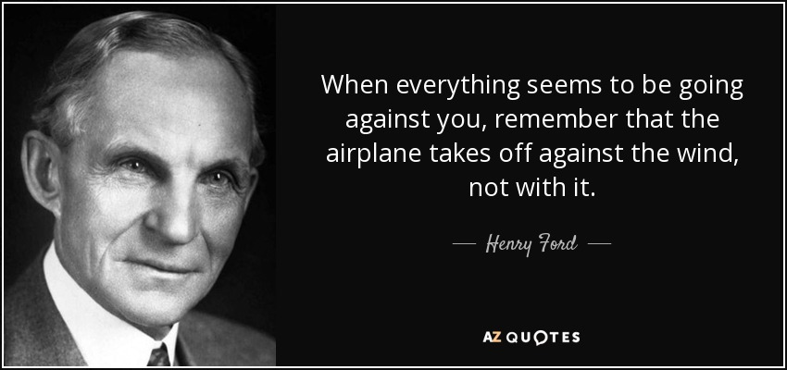
Closing Thoughts
“Whether you think you can, or that you can’t, you are usually right.” Henry Ford

Slide 21
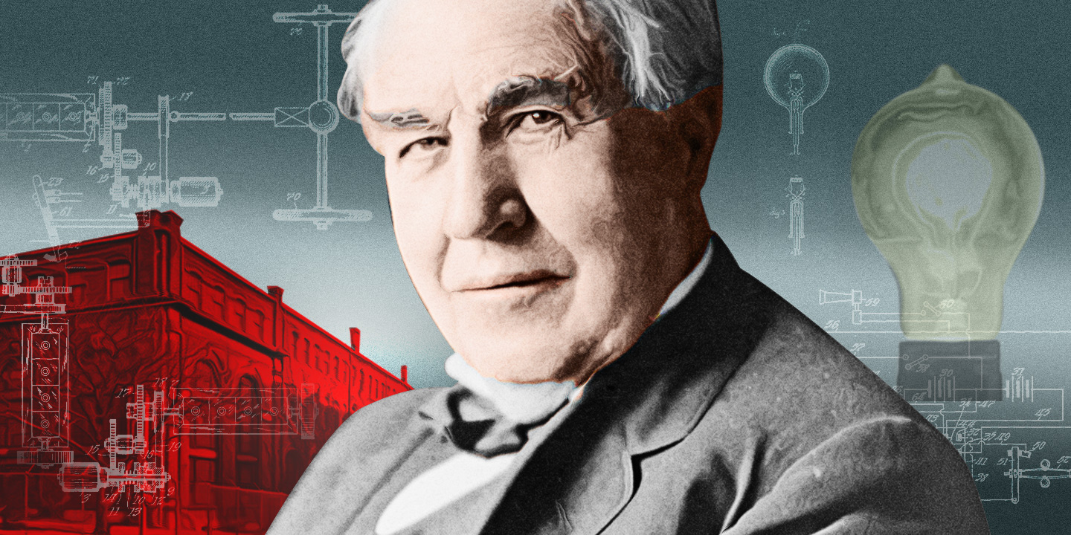
Closing Thoughts
“I have not failed. I have just found 10,000 ways that won’t work.” Thomas Edison

