Slide 1
Changing Families and Female Participation in the Labour Market
Andrew Triganza Scott
MBA (Maas), M.Ed (Melit), B.Psy (Hons), PGCE

Slide 2
Today it makes no more sense to talk about ‘women’s interests’ as an important, shared concept than it does to talk about ‘men’s interests’.
Three huge social changes have made the idea obsolete at best, and all too often perverse and harmful

Slide 3
Major Social Changes…
Social change (1) Female labour market participation .
Social change (2) Family structures.
Social change (3) Class differences, new and old – the fragmentation of ‘sisterhood’.

Slide 4
The new labour market:
Changing Female Participation
Major increases in female labour market participation.
Rise most striking for married women, upper and upper-middle income women and older women.
Also involves huge increase in part-time employment.
Part-timers largely female – but part-time employment is far more common for some groups of women than others.

Slide 5
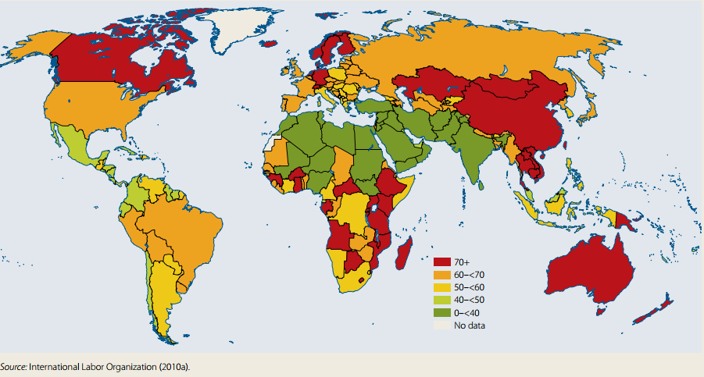
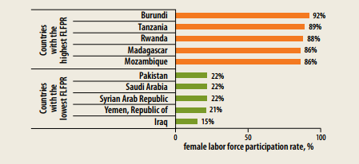

Slide 6
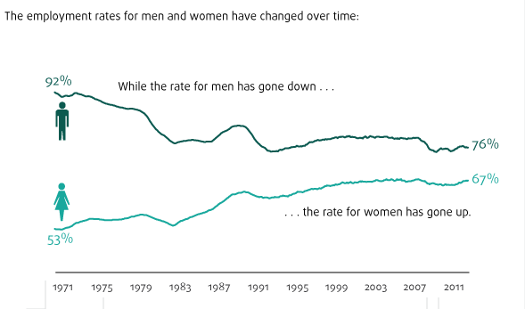
Female Labour Market Participation

Slide 7
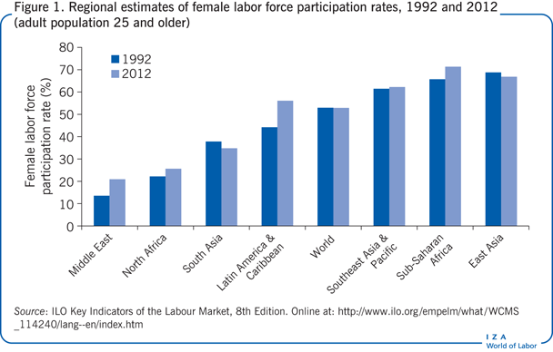
Female Labour Market Participation

Slide 8
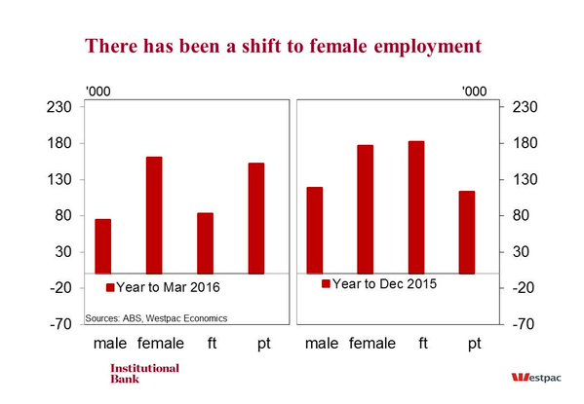
Male/Female Full-time and Part-time Employment Shift

Slide 9
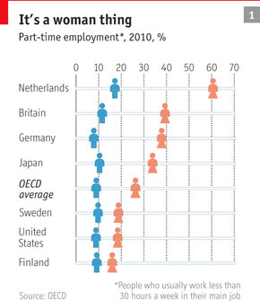
Part-time Employment Shift

Slide 10
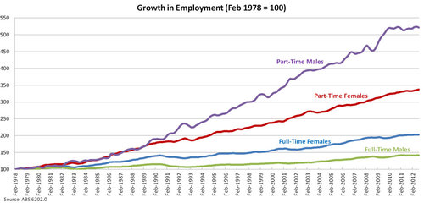
Growth in Employment

Slide 11
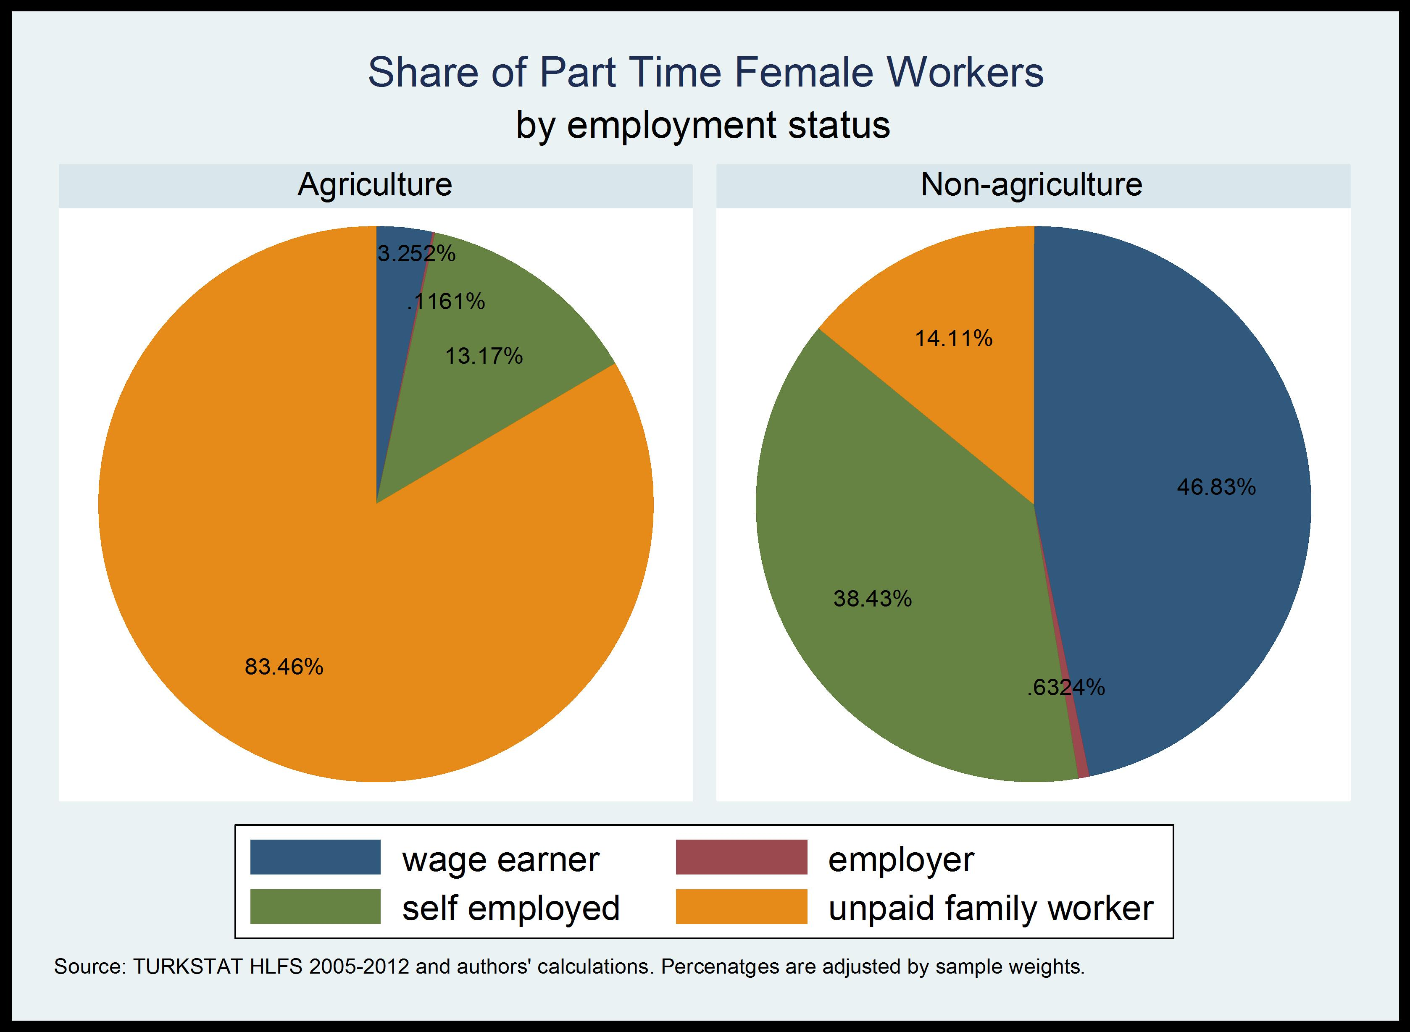
Part-Time Female Workers by Employment Status

Slide 12
The new labour market:
Changing Female Participation
Labour force participation rates have been increasing for women, falling for men, over the last quarter-century.
Women are under, but close to, half the entire labour force in developed countries.
Overall participation rates for women remain lower than for men.

Slide 13
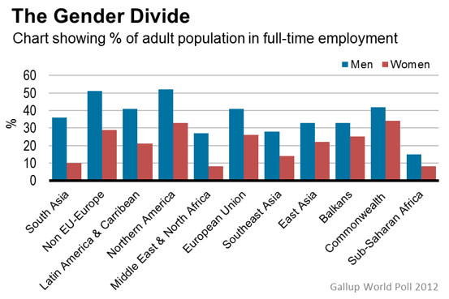

Slide 14
An International Assessment

Slide 15
The single most important change?
Participation of MARRIED women

Slide 16
This change came early in the US, somewhat later in Western Europe

Slide 17
Notes:
Source: Costa, J of Ec Perspectives

Slide 18
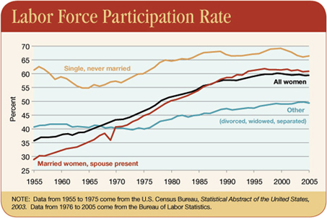

Slide 19
CHANGING FAMILY STRUCTURES

Slide 20
MARRIAGE PATTERNS
Fewer marriages, more divorces.
More childless adults (men and women).
More single-parent families, overwhelmingly headed by women (both once-married and never-married).

Slide 21
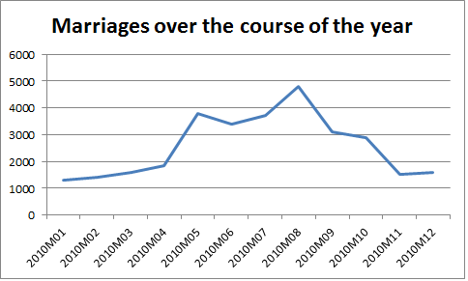
Changes In Marriage Trends

Slide 22
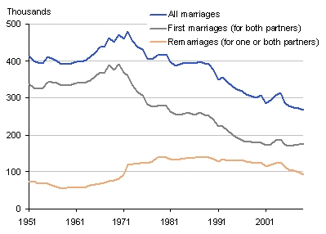
Changes In Marriage Trends

Slide 23
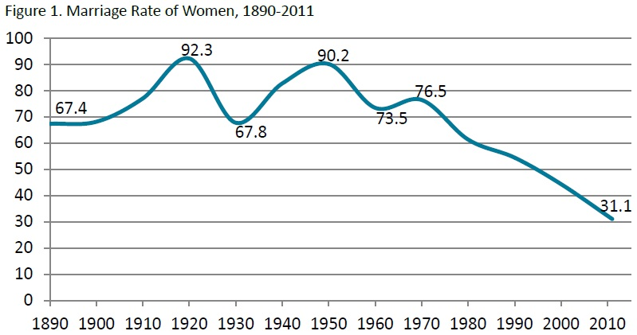
Changes In Marriage Trends

Slide 24
CHILD-BEARING PATTERNS
Big decreases in average family size.
Big increase in number of women and men who never have a child.
Very very few families with 3+ children.
Malta’s national average family size has
1.8 children

Slide 25
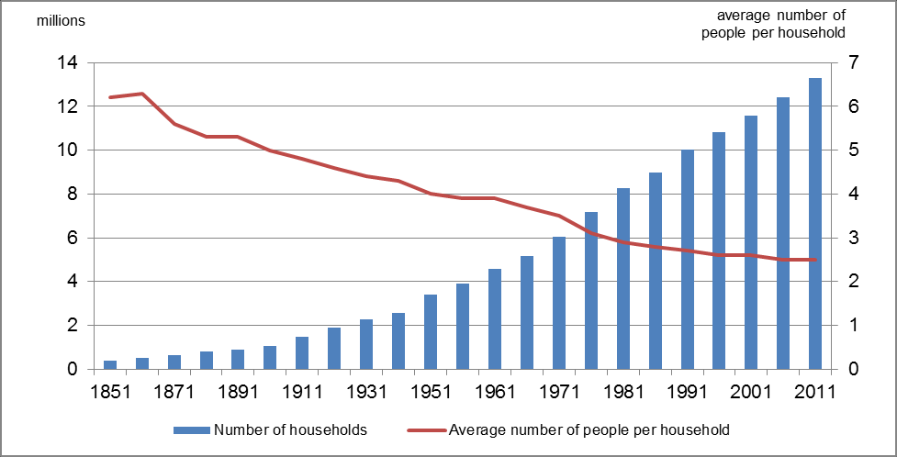
Average Family Size

Slide 26
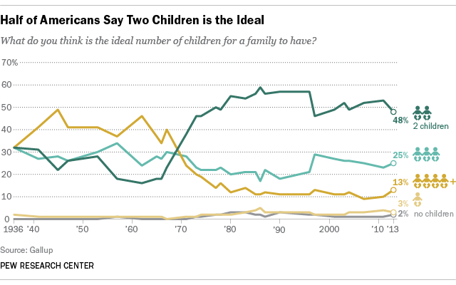
Average Family Size

Slide 27
Decrease in family size is universal
Other changes differ enormously by class and education

Slide 28
MAJOR DIFFERENCES BETWEEN MORE AND LESS EDUCATED
Very large increase in average age at marriage and average age at first child
for the highly educated only.
Very large increase in the number who never have a child, men and women, for the highly educated only.
‘Large’ (3+) families concentrated among the very affluent and immigrant/some second generation groups.

Slide 29
INTER-GENERATIONAL LINKS
Families are still the most important source of care and support, not supplanted by welfare state.
For the very elderly, the infirm, the disabled, family support is critical. In some (many?) countries, including the UK, state payments are increasingly concentrated – ‘minor’ disabilities fall on families.
Grandparents play a major and increasingly important role in child care, for both single and two-parent families.

Slide 30
The death of sisterhood

Slide 31
Social change has generated major and growing differences in the career and family paths of more and less educated women.
Educated women have jobs which are the same as those of educated men, and if they do not have children, their salaries are the same.
Their work patterns are different, their family patterns are different.

Slide 32
Male and female jobs: UK 1930

Slide 33
Male and female jobs UK 1999

Slide 34
% Female: Selected Professions UK (1971, 2009)

Slide 35
For the top 15% of jobs, taken overall, gender equality has arrived

Slide 36
Work patterns differ by education more than by gender
(and for childless graduates they don’t differ by gender at all)

Slide 37
Huge growth internationally in female part-timers

Slide 38
But not all women…
Part-time work is more likely for
Less-educated
Lower-paid
Older
With care responsibilities
THESE GROUPS TAKE LONGER BREAKS WHEN THEY HAVE SMALL CHILDREN
Part-time work is less likely for
Highly educated
Well paid
Younger
Professional jobs
GRADUATE WOMEN TAKE VERY SHORT BREAKS FROM THE LABOUR MARKET

Slide 39
Diverging lifestyles
The less educated –
Work throughout most of adult life
Often work part-time to fit in family demands
More often single parents
Work shifts
Partner also often works shifts
‘Job’ not career
Work in female-dominated sectors
The more educated -
Work mostly full-time
Take very short breaks for children
Are rarely single mothers at birth, divorce less
Work long but ‘normal’ days
Career-oriented
Work alongside men
Employ domestic help

Slide 40
Large proportions of the non-graduate workforce is in sectors where many jobs are still either heavily female (and traditionally so) or heavily male (and traditionally so).
The stronger and larger the welfare state, the more this is true.

Slide 41
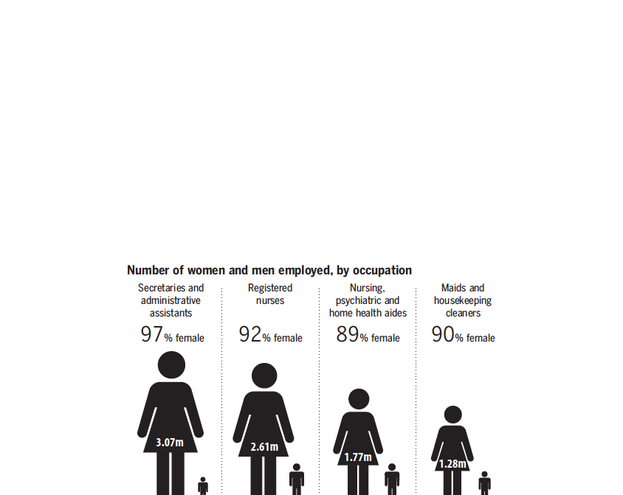

Slide 42
This is why there is a ‘pay gap’
Many desirable jobs are not available part-time. This is not, normally, prejudice (and if it were, would be economically self-defeating).
Many part-time jobs are in low-paid sectors
Many part-time workers have had interrupted employment histories
NB AMONG part-time workers, women’s average hourly pay is higher than men’s

Slide 43
Childcare and employment
Care of small children is intrinsically labour-intensive and expensive
Private payments are post-tax
Seen as major barrier to female employment
Vocal demands for more state-supported, and institutional provision
UK has increased spending very rapidly, now second-highest spender in OECD

Slide 44
But childcare patterns for UK 3 year olds show limits

Slide 46
In conclusion… a Feminist approach
Today’s self-proclaimed ‘new feminism’ has little to do with today’s labour market or today’s society, or with the acute problems faced by many non-privileged women.
It has been captured by a combination of highly-paid self-interest and commercial acumen (dressed up as moral outrage): and by a mindset which is that of an individualist, career-oriented elite.

